Slide 1




TR# 2017325

Slide 2


Side-by-Side
Selling
2 – Side-by-Side Selling
T-Mobile confidential and proprietary information. Not for customer distribution.

Slide 3

INTRO
What is side-by-side selling?
Shows we’re working together.
Demonstrates transparency.
Removes invisible barriers.
3 – Side-by-Side Selling
T-Mobile confidential and proprietary information. Not for customer distribution.

Slide 4


CUSTOMER CONNECT
4 – Side-by-Side Selling
T-Mobile confidential and proprietary information. Not for customer distribution.

Slide 5

PURCHASE ESTIMATE
Purchased
Still thinking about it
Already with us
5 – Side-by-Side Selling
T-Mobile confidential and proprietary information. Not for customer distribution.

Slide 6
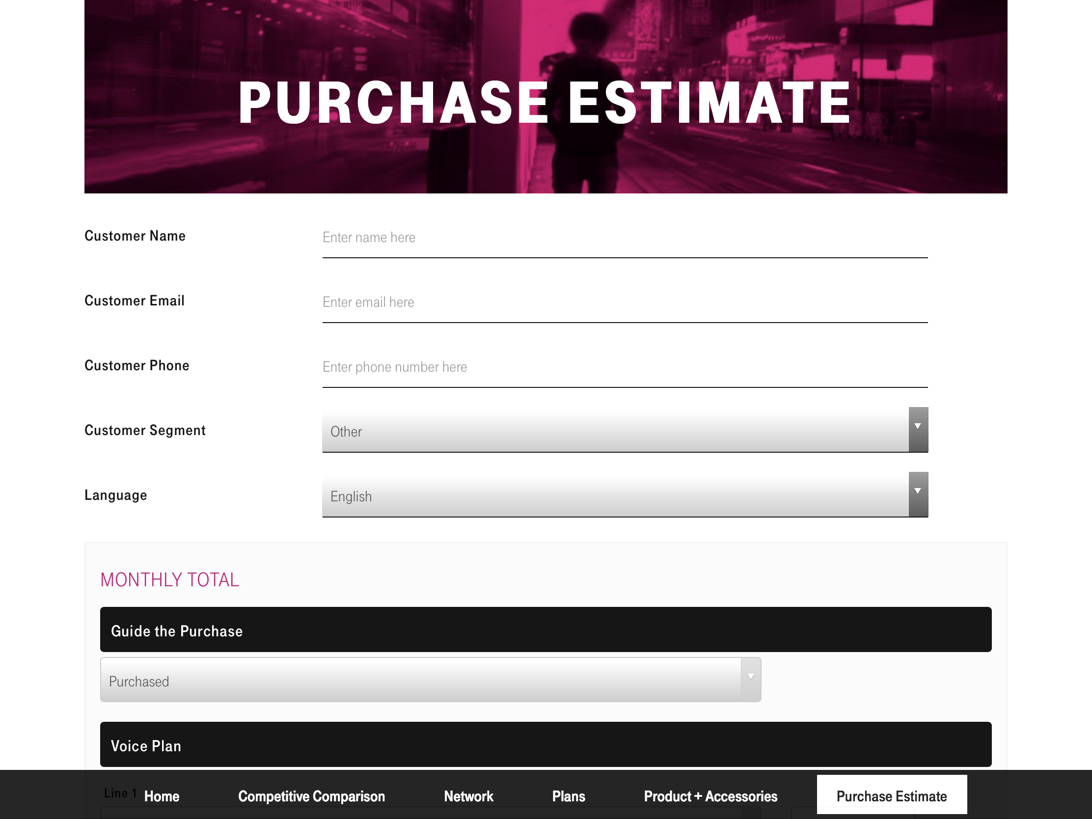
WALK THROUGH ACTIVITY
6 – Side-by-Side Selling
T-Mobile confidential and proprietary information. Not for customer distribution.

Slide 7

The Download
What are the benefits of providing our customers with a Purchase Estimate?
What ways could a Purchase Estimate help prevent confusion for our customers?
7 – Side-by-Side Selling
T-Mobile confidential and proprietary information. Not for customer distribution.

Slide 8

Sales Floor Activities
See it!
Log in to T-Mobile Connect
Tap ‘Customer Connect’
Spend time getting familiar with:
Competitive Comparison
Network
Plans
Product + Accessories
Purchase Estimate
Look for…:
What ways could you use this tool with a customer?
How do each of these tools enhance the customer experience?
8 – Side-by-Side Selling
T-Mobile confidential and proprietary information. Not for customer distribution.

